Slide 1

3D UNet-like Segmentation
Jin Cui

Slide 2


01

Slide 3
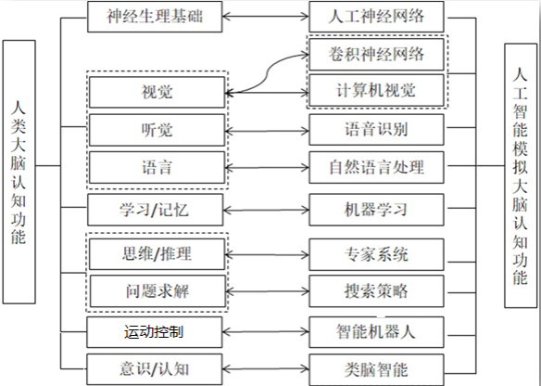

BACKGROUND

Slide 4
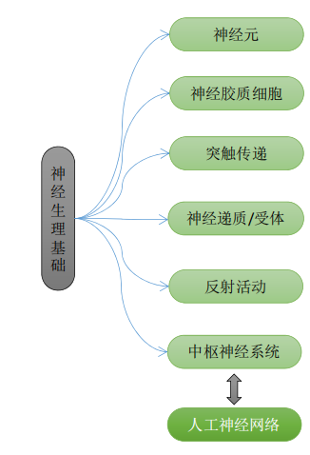
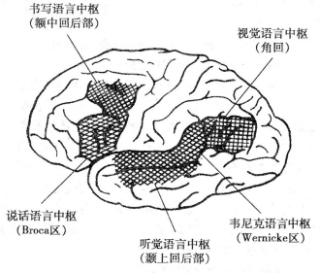
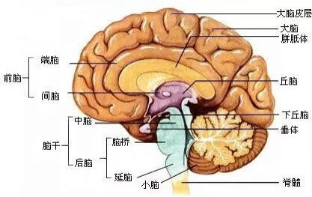
BACKGROUND

Slide 5
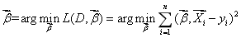
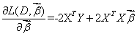
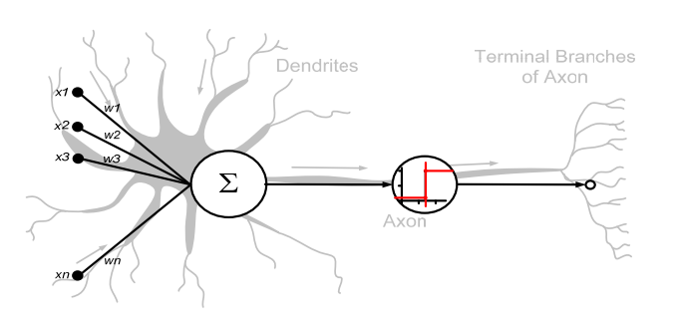
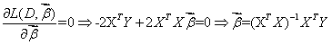
BACKGROUND
. Now putting the independent and dependent variables in matrices X and Y, respectively, the loss function can be rewritten as:
As the loss is convex, the optimum solution lies at gradient zero. The gradient of the loss function is (using Denominator layout convention):
Setting the gradient to zero produces the optimum parameter:

Slide 6
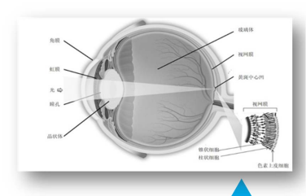
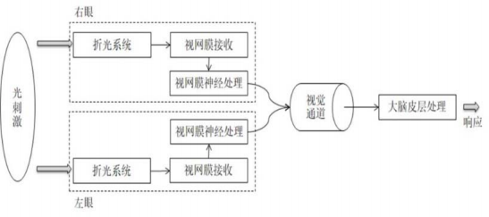
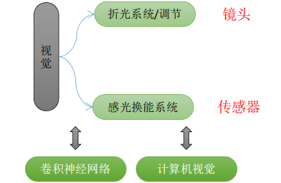
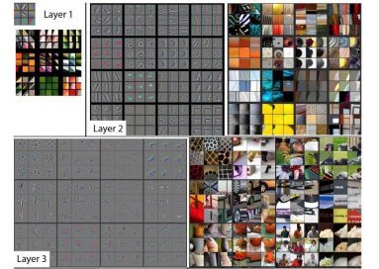
BACKGROUND

Slide 7
02

Slide 8

ABOUT THE MODEL
Using UNET-like architecture for medical image segmentation:
Highlighting the need for per-pixel classification for some visual tasks(biomedical images)
Working well on small number of examples
Balancing precise localization and segmentation details

Slide 9
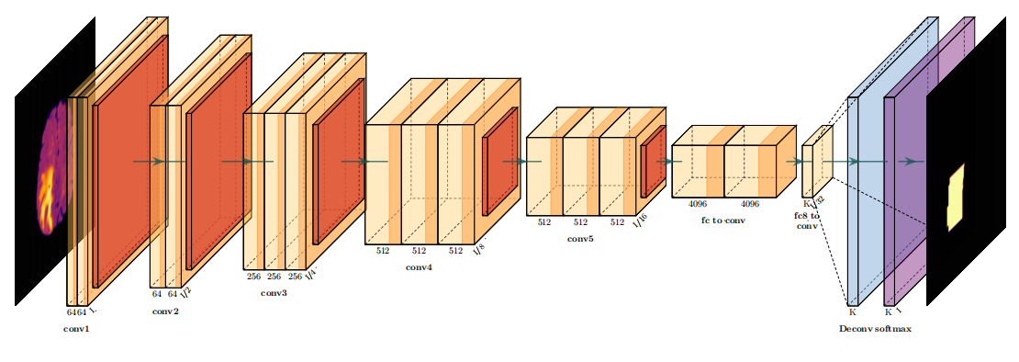
Common Fully Connected Network(FCN) Architechture

Slide 10

Oringinal U-Net Model: Encoder-Decoder Architechture

Slide 11
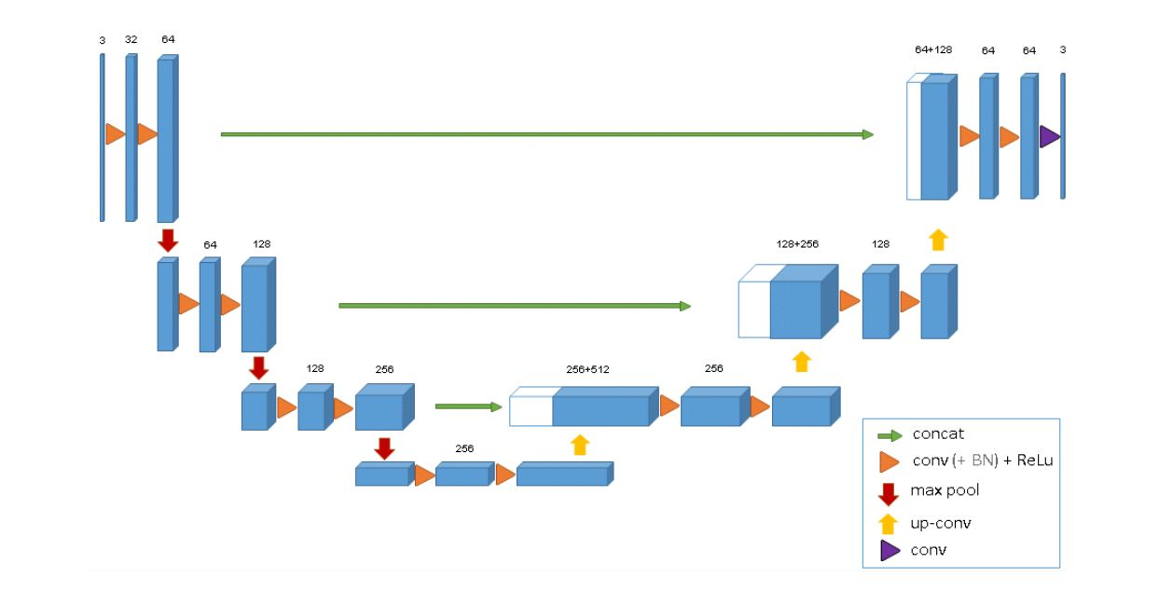
Three Dimensional Encoder-Decoder Architechture
3D layer convolution and concatenation(SOTA!!!)

Slide 12
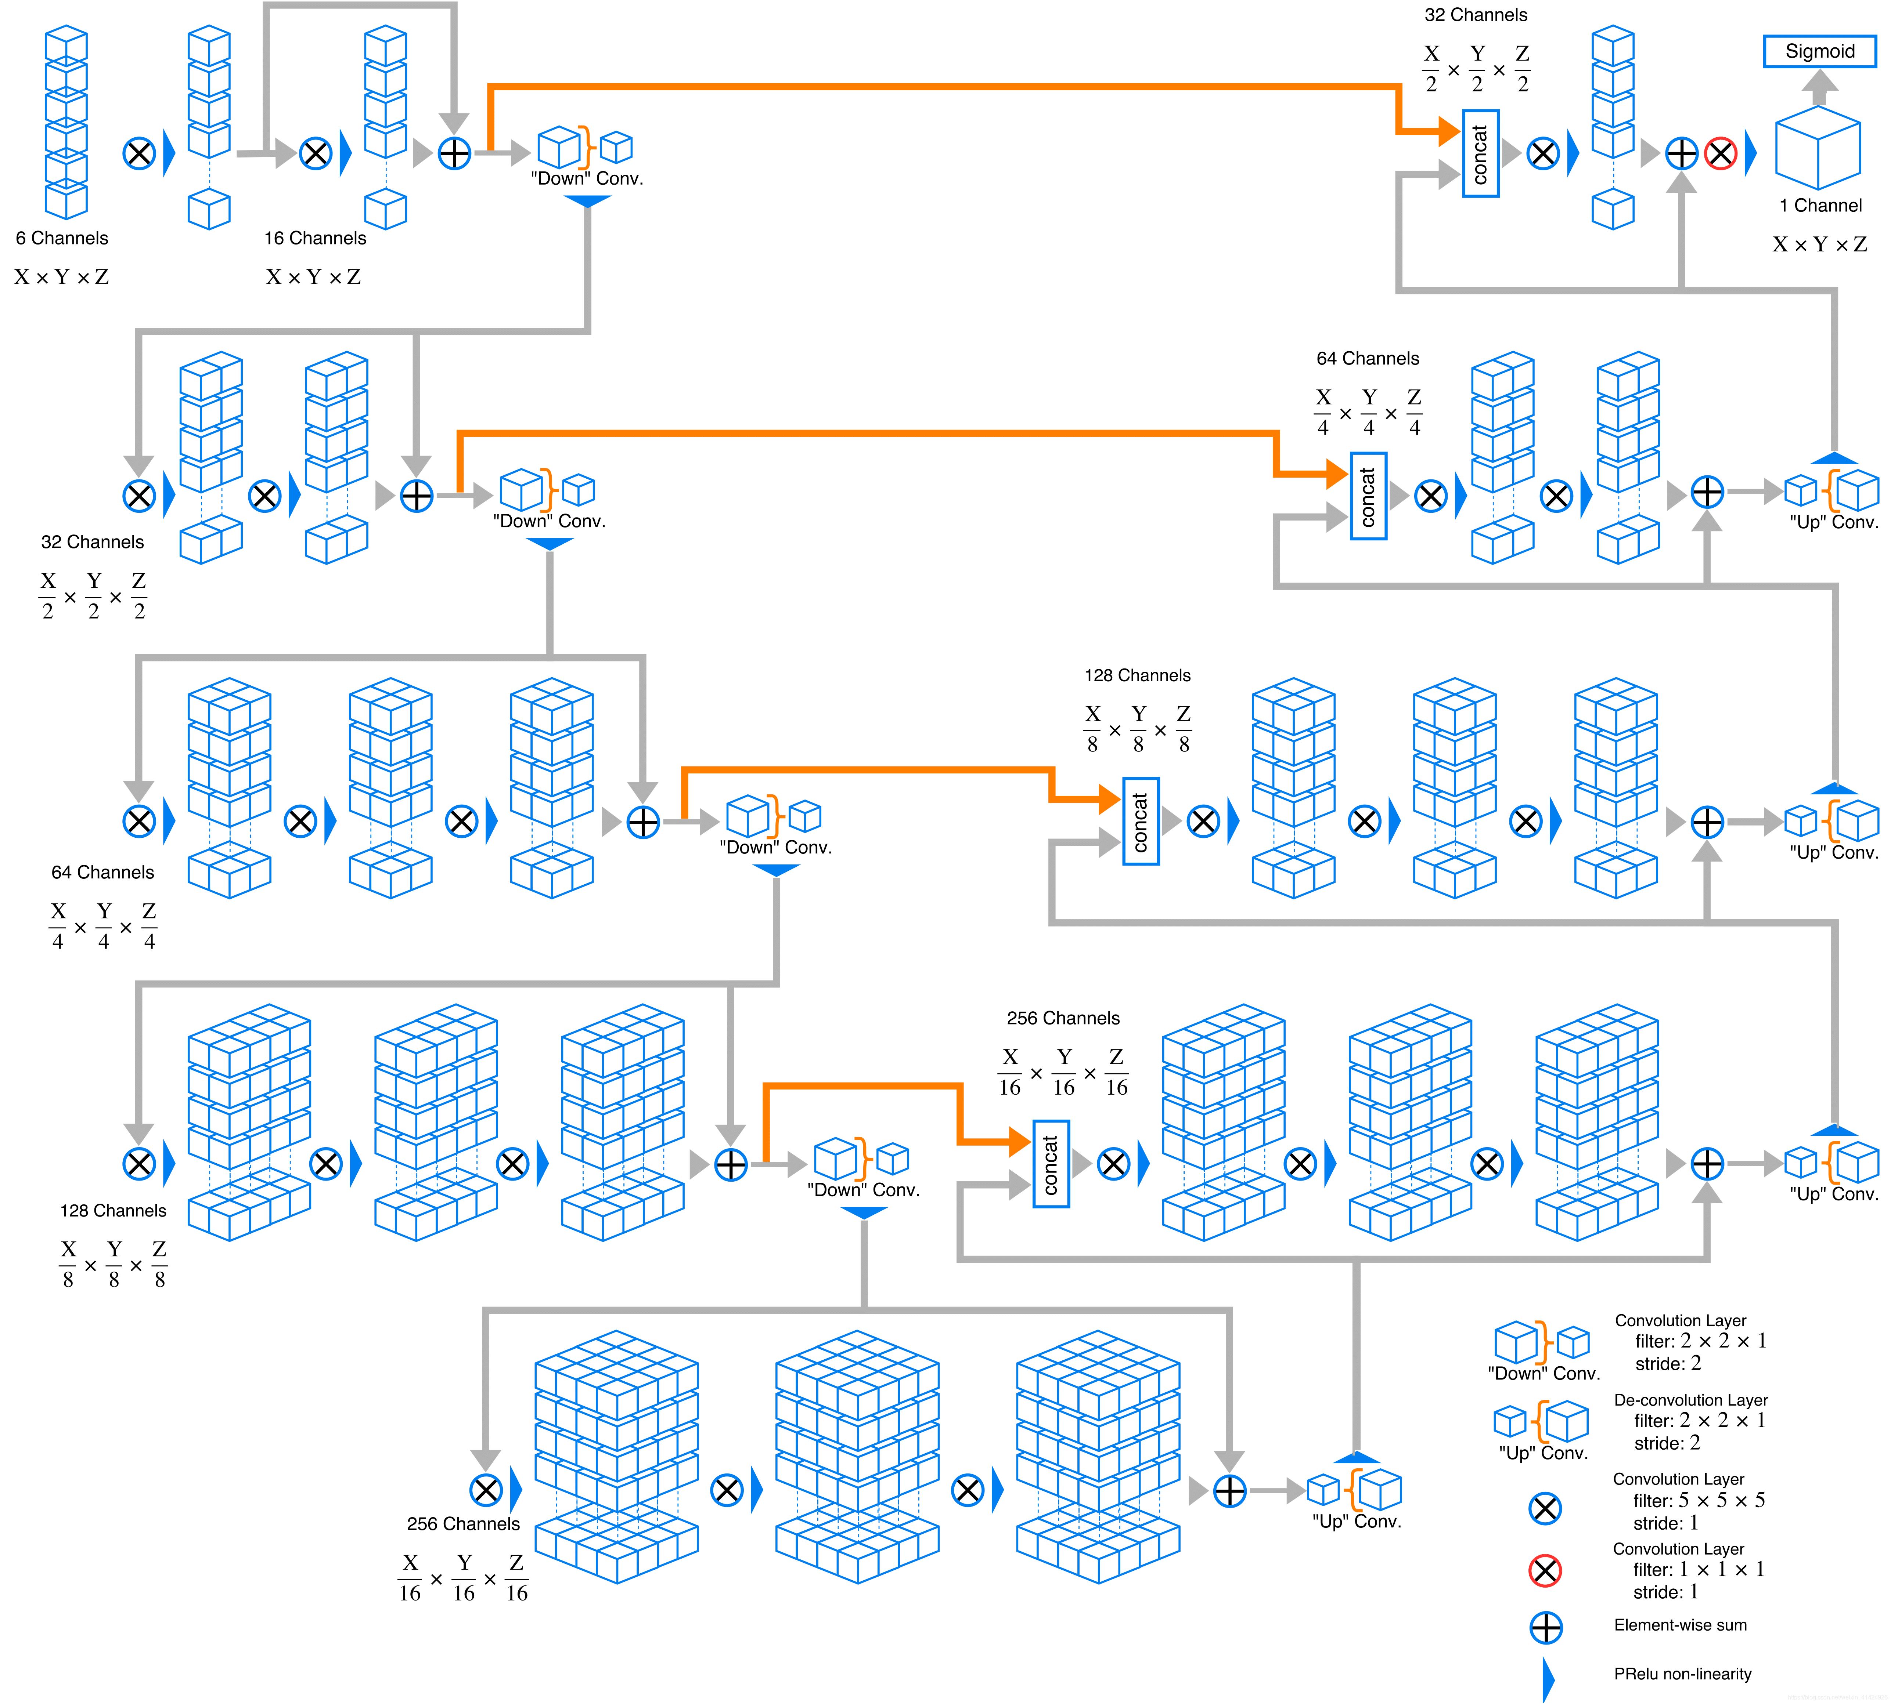
3DVNet
由于本周服务器不稳定导致训练数据的输出暂时无法展示
可以推测其性能不逊于3DUnet

Slide 13
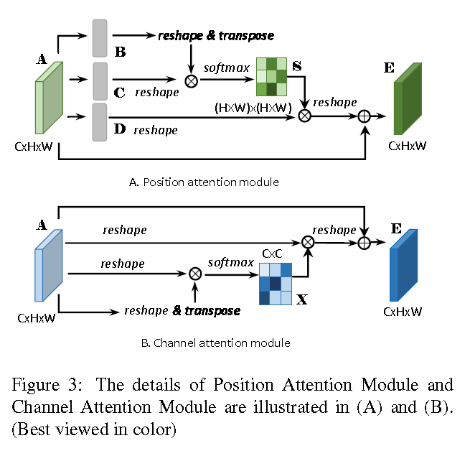
3DDualAttentionVNet
本模型正在开发中
主要特点是加入了注意力机制来提取局部和全局自信息
代码具体运行遇到一定困难，愿意同上
预期性能应强于之前模型

Slide 14
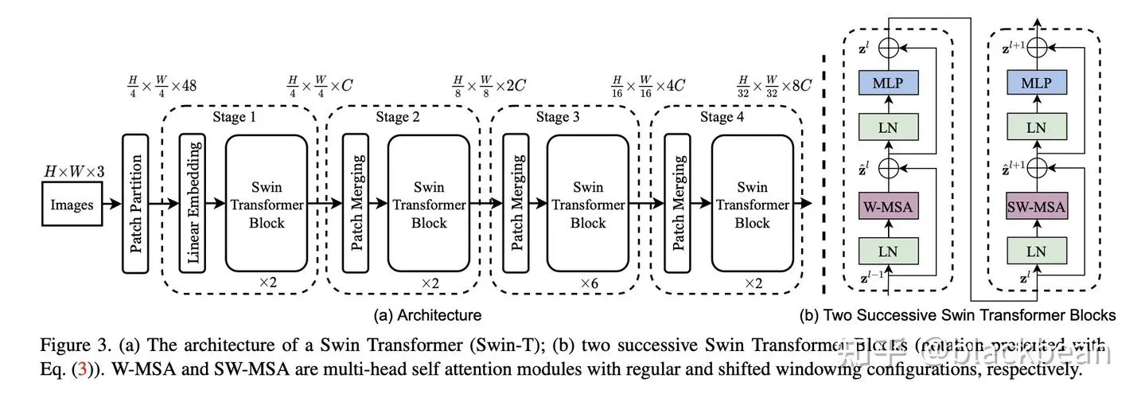
3DShiftedWindowTransformerVNet
模型预研中，图示为现已发表的2D网络结构，3D结构仍需开发（目前尚未发现发表类似成果）

Slide 15
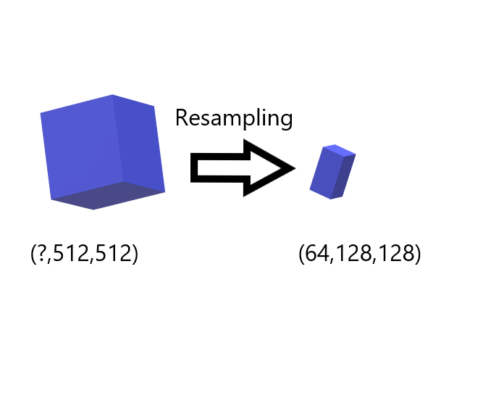
Data Preprocessing
Due to the depth of the input size is
Instable
Downsampling is necessary before entering the neural network because it can only receive specific input
Disadventage: lack of resolution

Slide 16
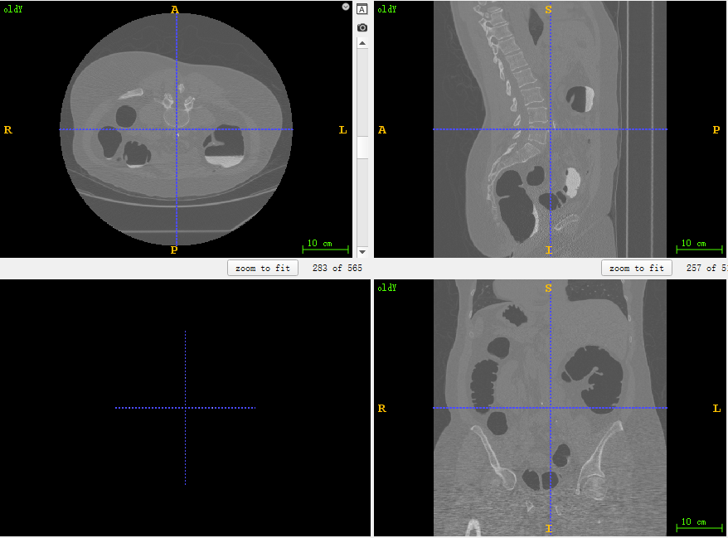
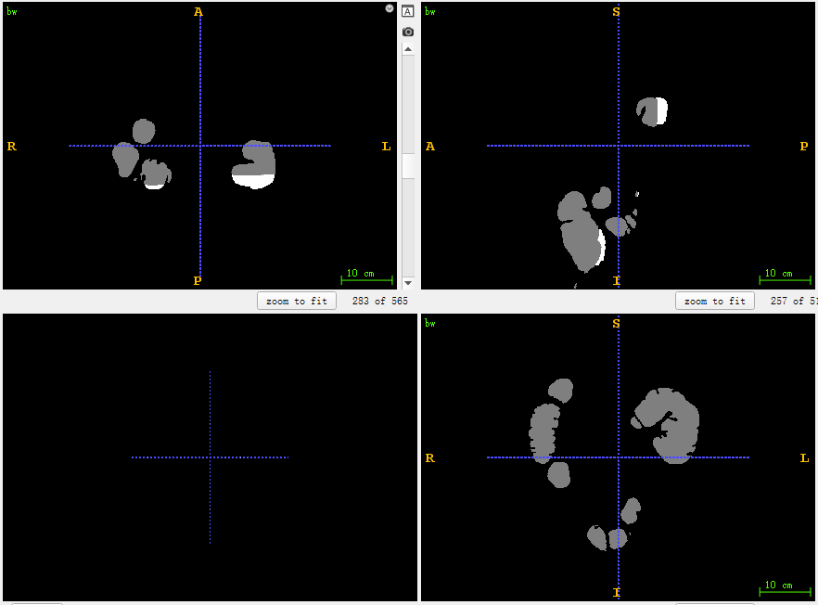
Visual Presentation
data sample in ITK-SNAP
segmentation mask in ITK-SNAP

Slide 17
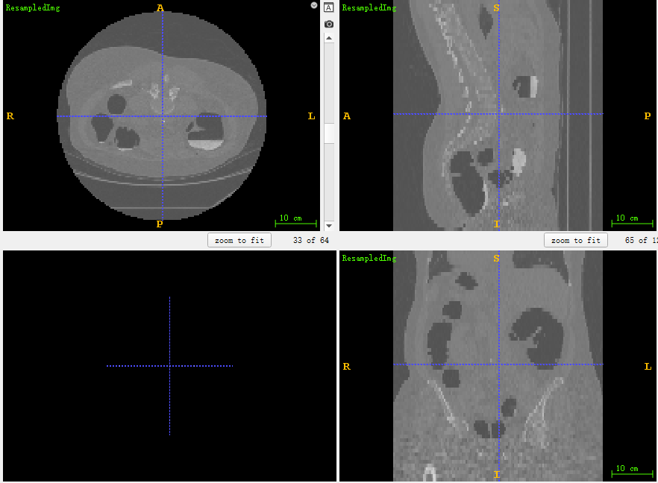
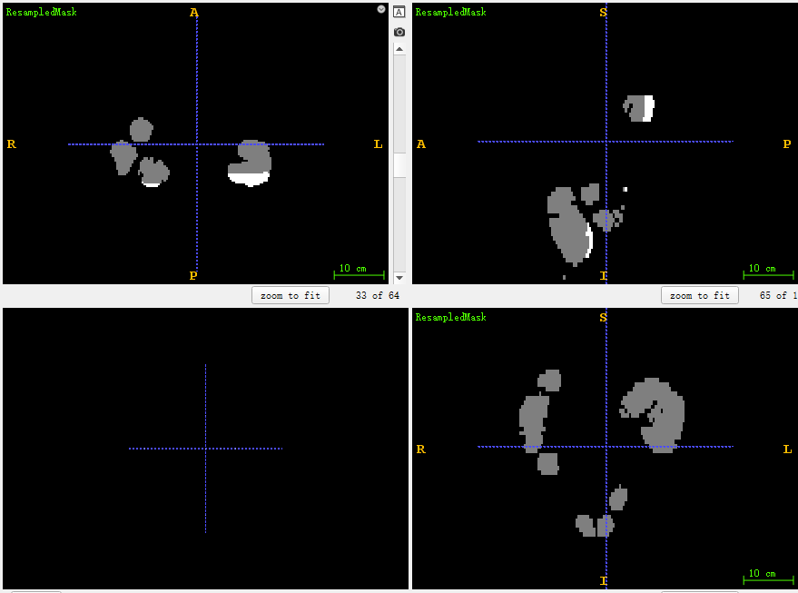
Visual Presentation
data sample in ITK-SNAP after resampling
mask in ITK-SNAP after resampling

Slide 18
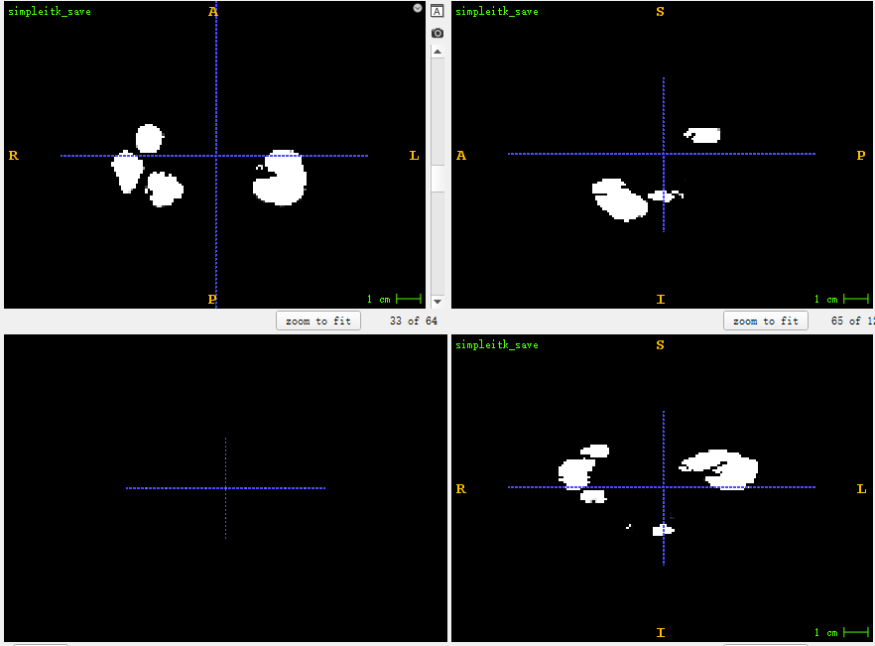
Visual Presentation
3D segmentation result(3DUNet)
mask in ITK-SNAP after resampling

Slide 19


Evaluation Metrics
Loss Function：
$L_{CE} = −\sum_{i=1}^{n}{t_{i}log(p_{i})}$ (binary crossentropy)
$Dice = \frac{2|GT∩SR|}{|GT|+|SR|}($Sørensen–Dice)
GT:ground truth
SR:segmentation results
$Jaccard/IoU = \frac{GT∩SR}{GT∪SR}($Intersection over union)

Slide 20
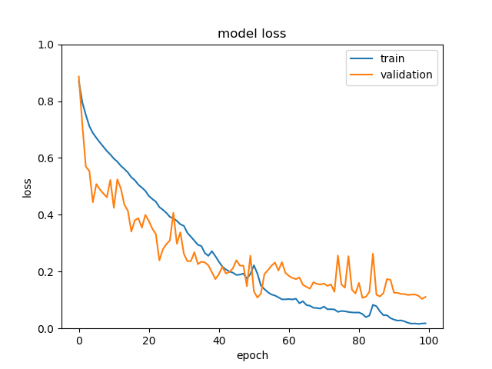
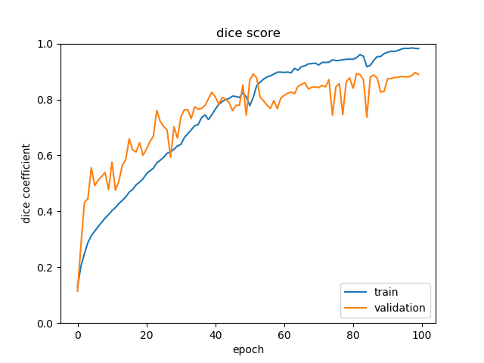
Evaluation Metrics
3DUNet

Slide 21
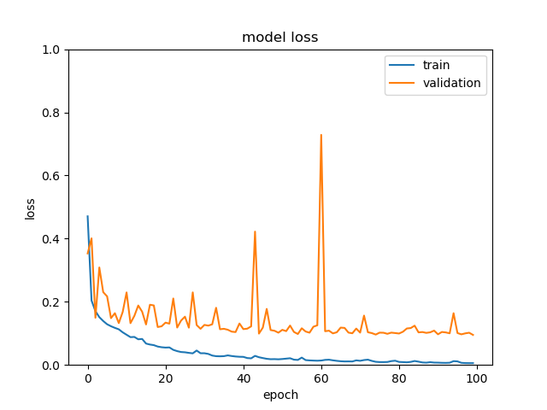
Evaluation Metrics
3DVNet

Slide 22
Thanks for watching

